Slide 1
Process Walk-through

Slide 2
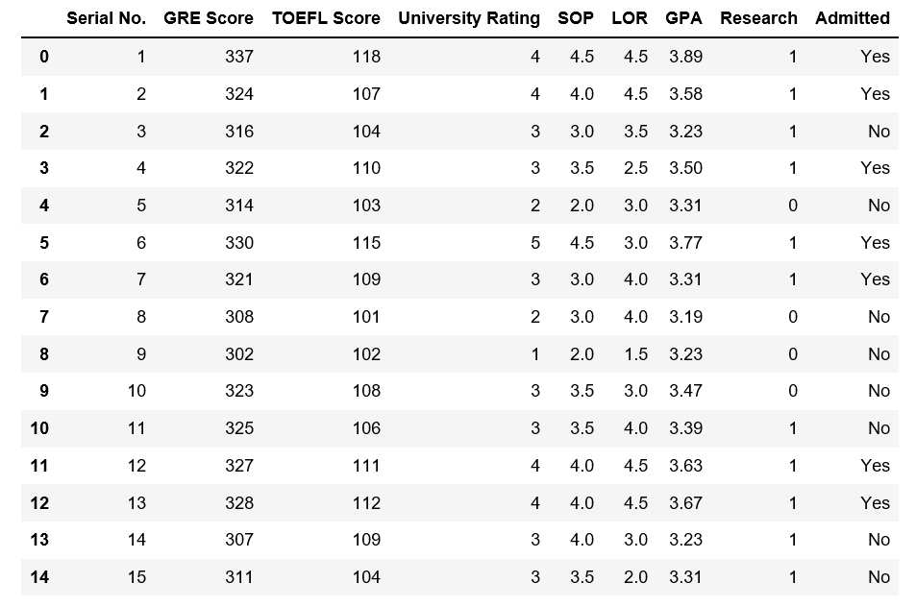

Slide 5
Exploratory Data Analysis

Slide 6
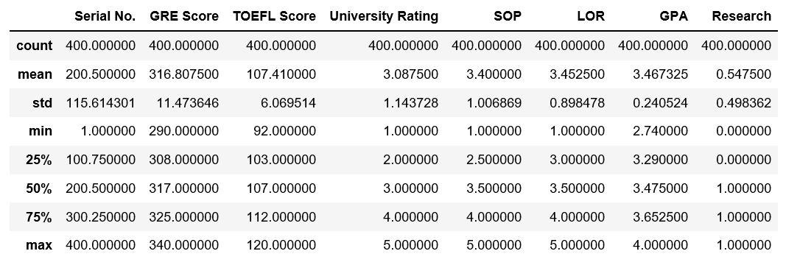
Explore Numerically

Slide 7
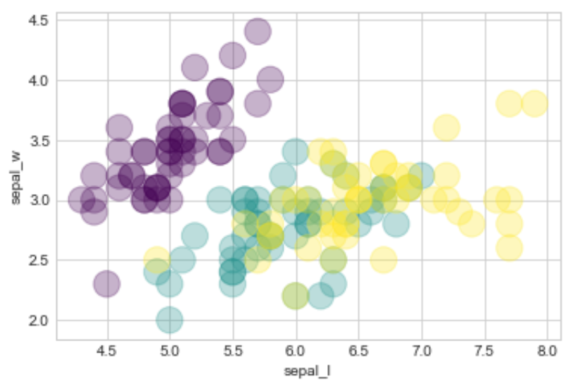
Explore Visually

Slide 8
Clean the Data

Slide 9
Data Transformation

Slide 10
Categorical to Binary Encoding

Slide 11
Categorical to Binary Encoding
Gender
Female
Male
Female
Female
Male
Male
Female
Gender
1
0
1
1
0
0
1

Slide 12
One-hot Encoding

Slide 13
One-hot Encoding
Race
Asian
Black
White
Pacific Islander
American Indian
White
Black
American Indian | Asian | Black | Pacific Islander | White
0 | 1 | 0 | 0 | 0
0 | 0 | 1 | 0 | 0
0 | 0 | 0 | 0 | 1
0 | 0 | 0 | 1 | 0
1 | 0 | 0 | 0 | 0
0 | 0 | 0 | 0 | 1
0 | 0 | 1 | 0 | 0

Slide 14
Scaling

Slide 15
Normalizing
(Min-Max scaling)
Standardizing
(Z-score)
x – min(X)
max(X) - min(X)
x – mean(X)
std(X)
z =

Slide 18
Fix Skewness

Slide 19
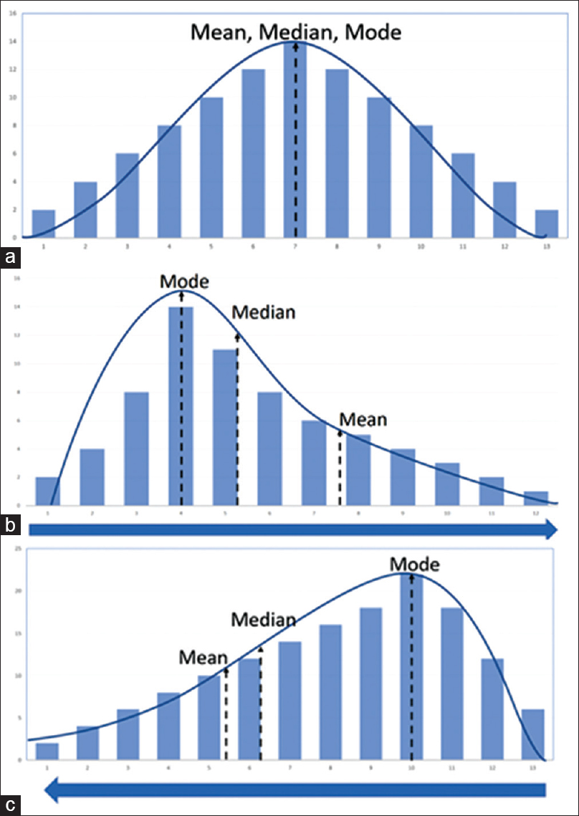

Slide 20
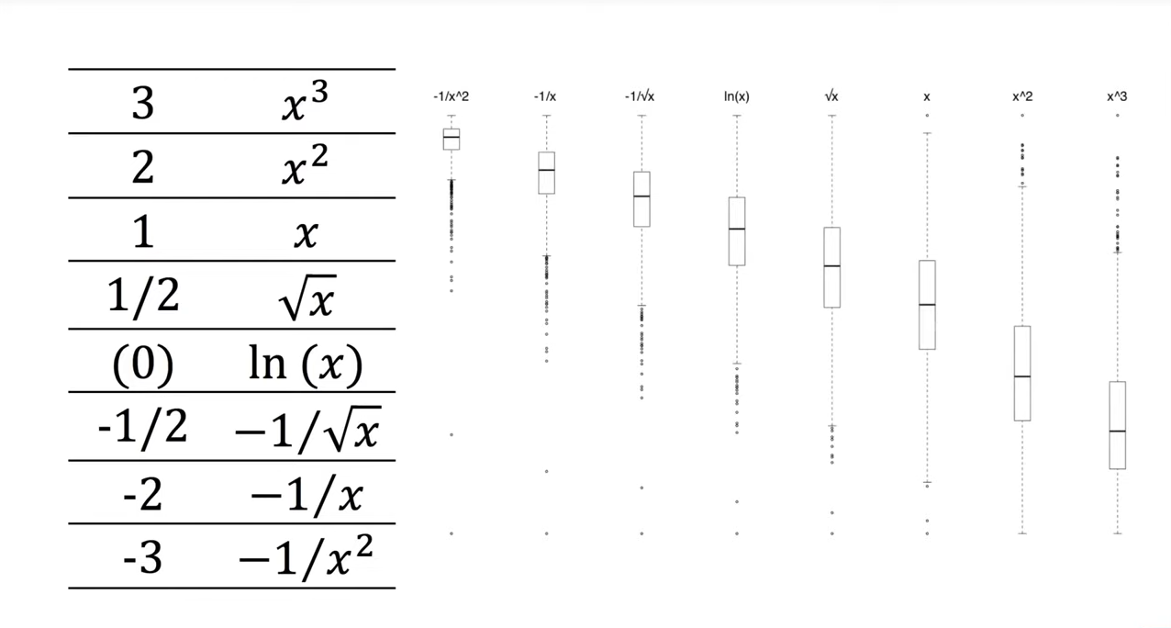




Slide 21
Hypothesis Testing

Slide 22
Question:
What is the probability of this occurring randomly by chance?

Slide 23
If the probability is low, then you would reject randomness as a likely explanation

Slide 24
Machine Learning

Slide 26
